Slide 1
WATER QUALITY IN GERMANY
Ali Alnawakhtha
Ahmed Alarayedh
DAB-6

Slide 2
OBJECTIVES
Assess the water quality in Germany
What are the reasons behind “Events” ?
01
02

Slide 3
UNDERSTAND THE DATA
Redox
Leit (Conductivity)
Tureb(Turbidity )
Event
Reactions that help clean drinking water by killing harmful microbes.
Preferred : 650-850 mV
Measures dissolved salts and minerals in water, indicating purity
Preferred : 50–500 µS/cm
Measures water clarity; high turbidity means potential contaminants
Preferred: <1 NTU
False : Everything is normal
True: Something went wrong

Slide 4
Water Quality During Day and Week

Slide 5
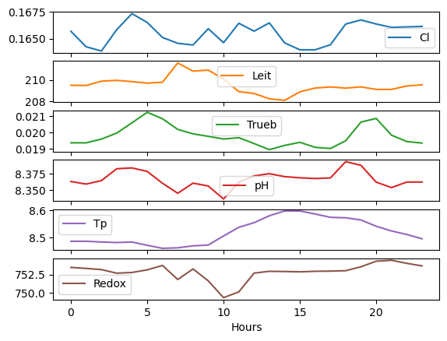
Hours vs Water Quality

Slide 6
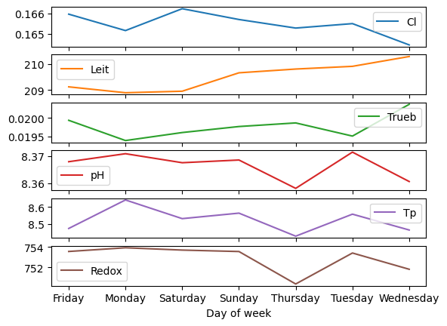
Days VS Water Quality

Slide 7
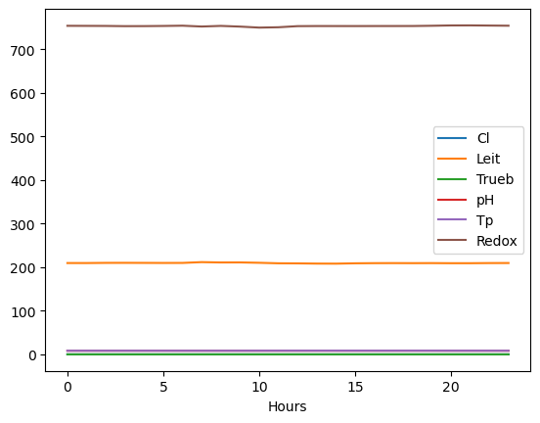
Water Quality During the Day

Slide 8
WHO vs. Our Dataset: A Comparative Analysis

Slide 9
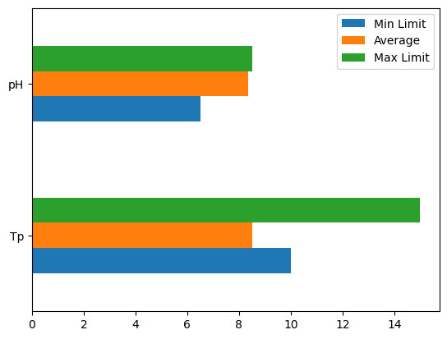
pH and Temperature °C

Slide 10
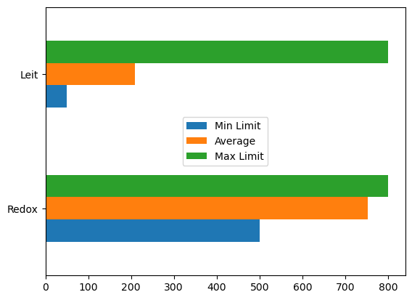
Conductivity and Redox

Slide 11
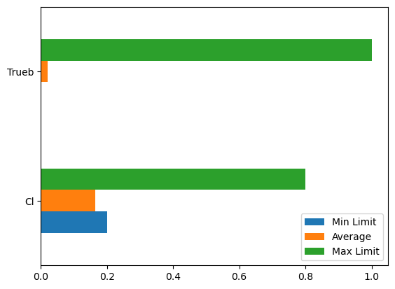
Turbidity and Chlorine Dioxide

Slide 12
Why Do Events Happen?

Slide 13
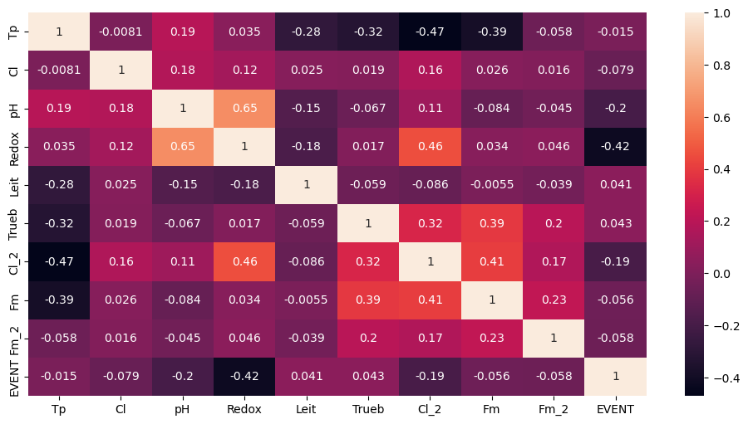
Heat-Map Analysis: Understanding Relationships

Slide 14
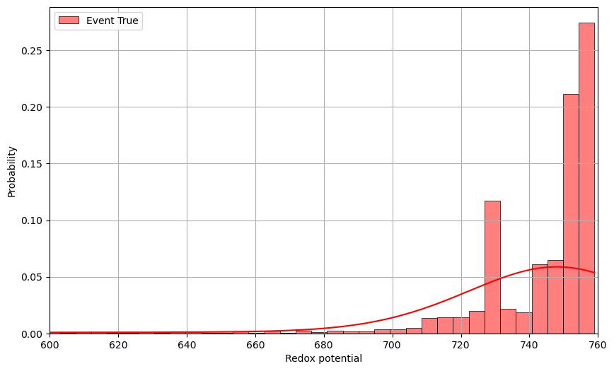
Redox Values: When Event Probability Peaks

Slide 15
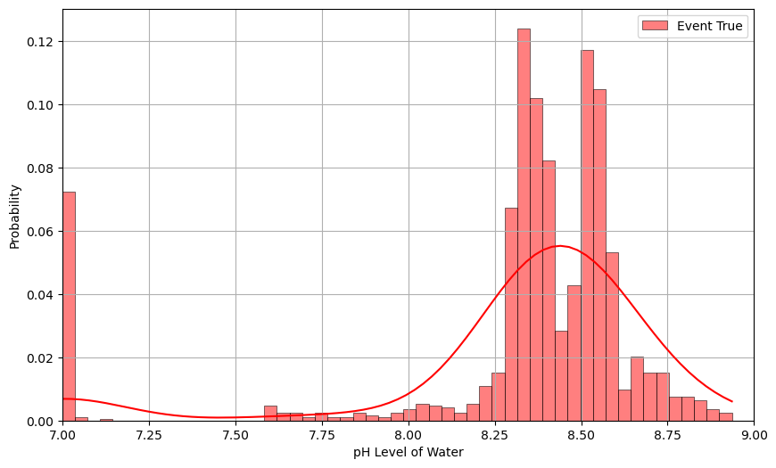
pH Levels: When Event Probability Peaks

Slide 16
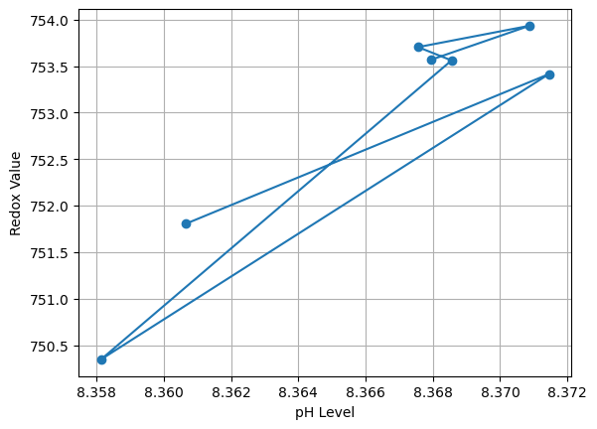
pH and Redox Relationship

Slide 17
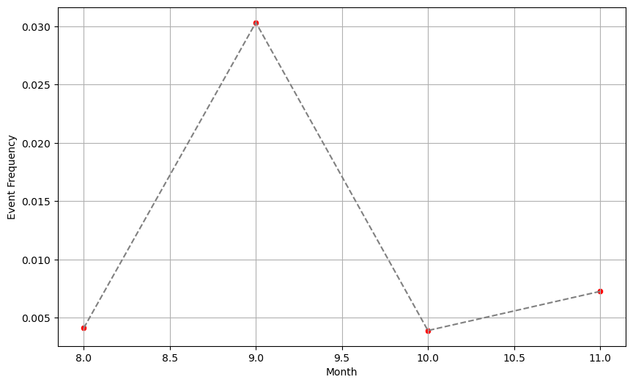
Which Months Have the Most Events

Slide 18
Conclusion & Recommendations
The water quality is mediocre
No real effect of time on water quality
Abnormalities “EVENTS” are mostly caused by pH and Redox changes
Decrease pH and Redox levels for better water quality and less events
September has the most EVENTS

Slide 19
THANKS!
Do you have any questions?

